Slide 1


MSc in Artificial Intelligence
Deep learning
Cryptocurrency price prediction
Adamantidis Theodoros | Papadopoulos Georgios
mtn 2001 | mtn 2025
July 05, 2021

Slide 2

Introduction
In the recent years, cryptocurrencies have been very popular because of their values change over time in a great extend.
In this project we tried to predict:
Cryptocurrency’s price over time (Regression problem)
Cryptocurrency’s trend (Classification problem)
Using:
Cryptocurrencies historical data
Social media feed
Worked with Tensorflow library using layers:
LSTM
GRU

Slide 3
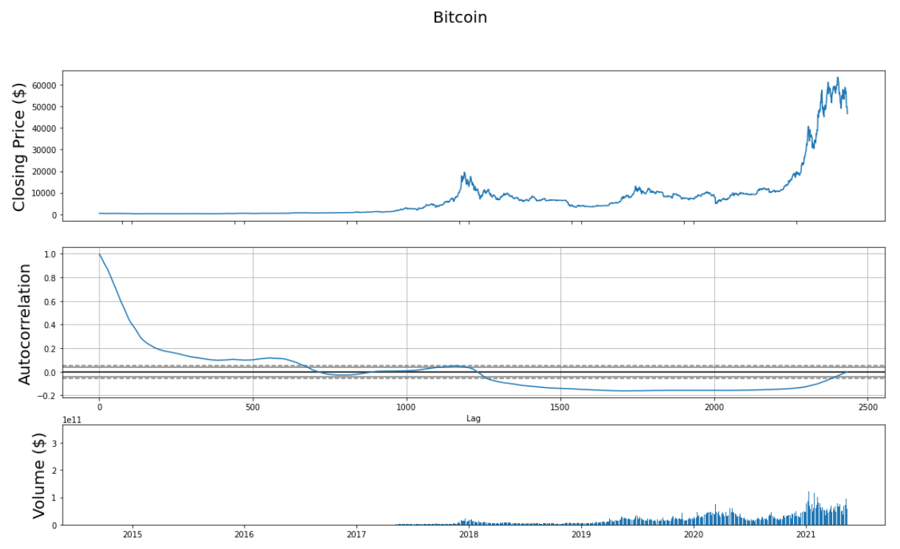
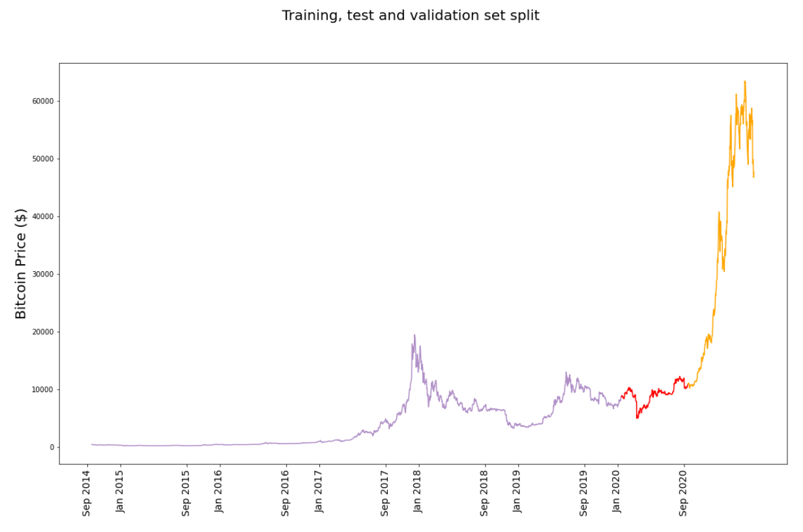
Data preprocessing
80% train set
20% validation, testing
50% each one
Differ among the experiments
Autocorrelation changes through time
Price increases over time
Solution?
Used windows normalization of 10 days

Slide 4
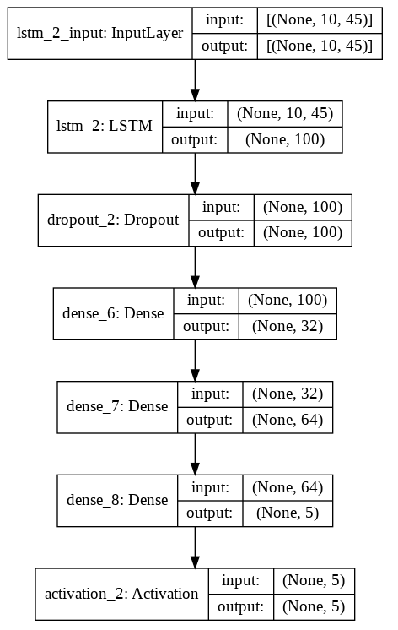
Regression with historical data - Hypertuning
After tuning (Hyperband alg.) the model, we ended up in the following:
Combinations of different coins increases performance.
Batch size 64.
LSTM output units 100.
Adam optimizer
MAE loss
Feature set:
Close
Open
High

Slide 5
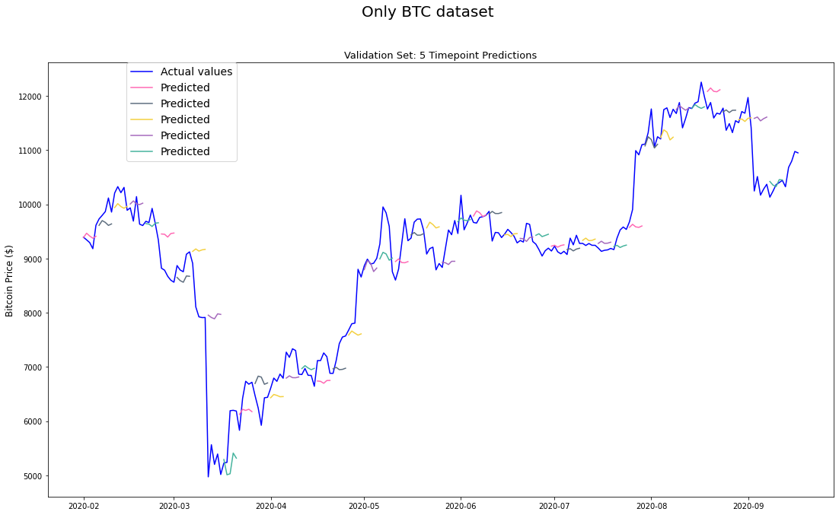
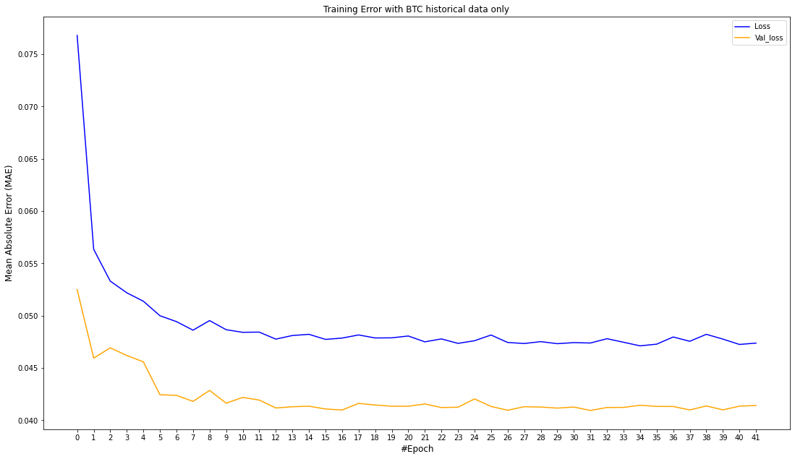
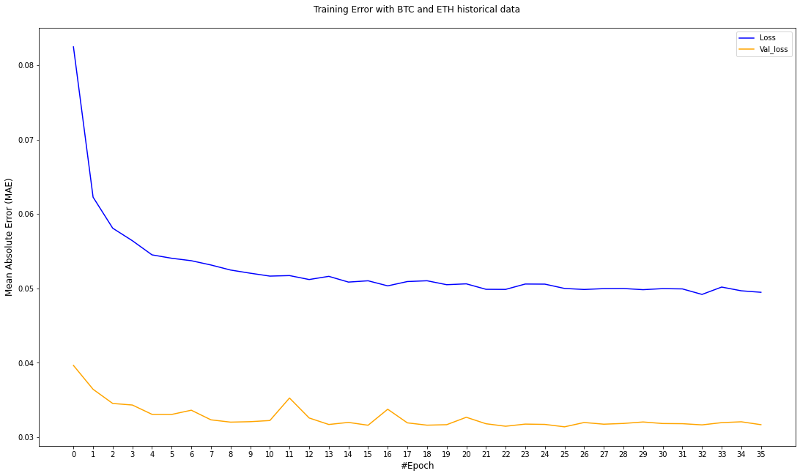
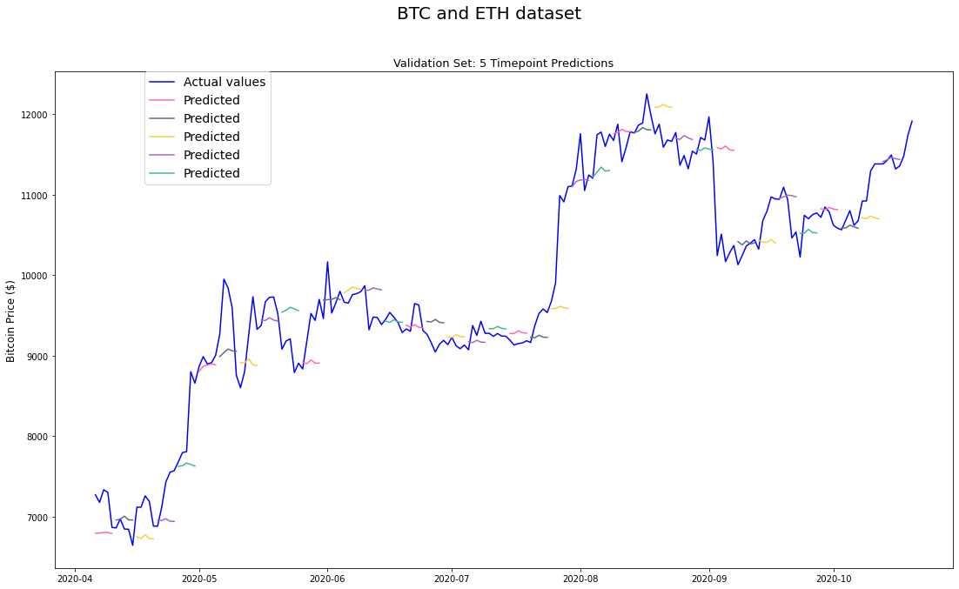
Regression with historical data - Results
Test set average MAE:
BTC Data, 0.056
BTC and ETH Data, 0.066

Slide 6
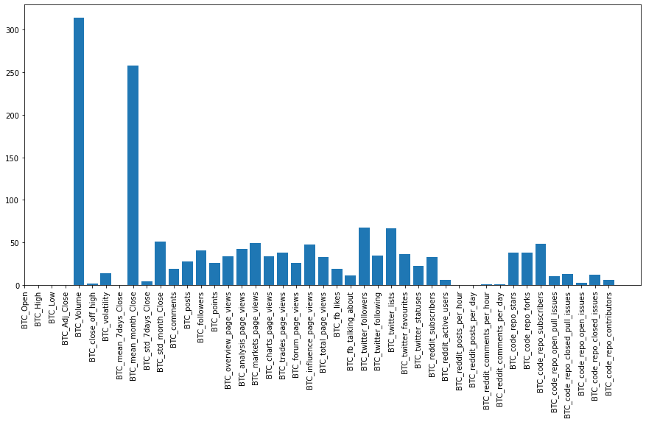
Regression with historical data and Social media feed
Social media feed data starts from 2017.
From the 33 available chose 5 after data preprocessing:
Twitter followers
code repo subscribers
Twitter favourites
Twitter following
Reddit subscribers

Slide 7
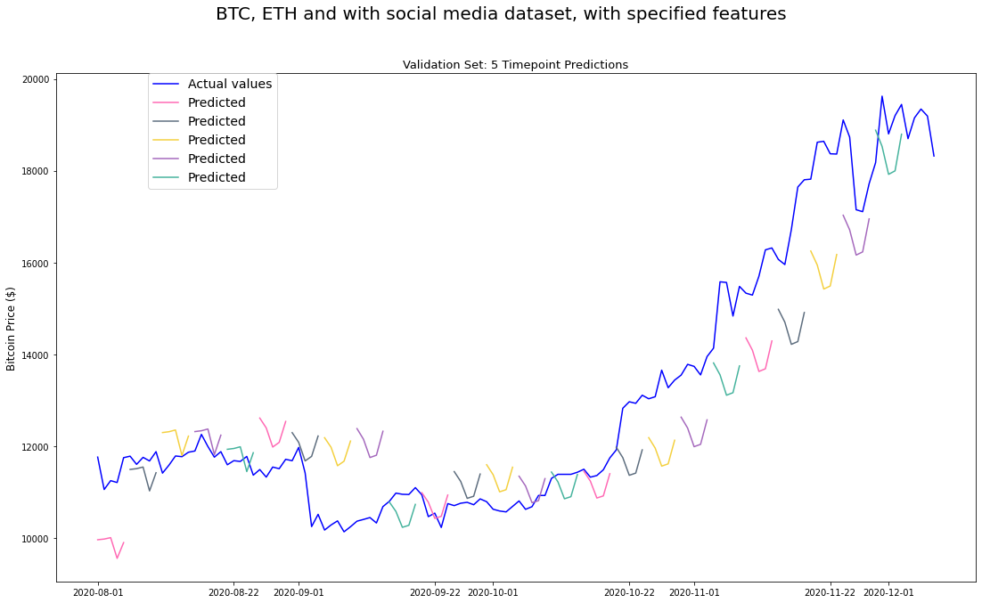
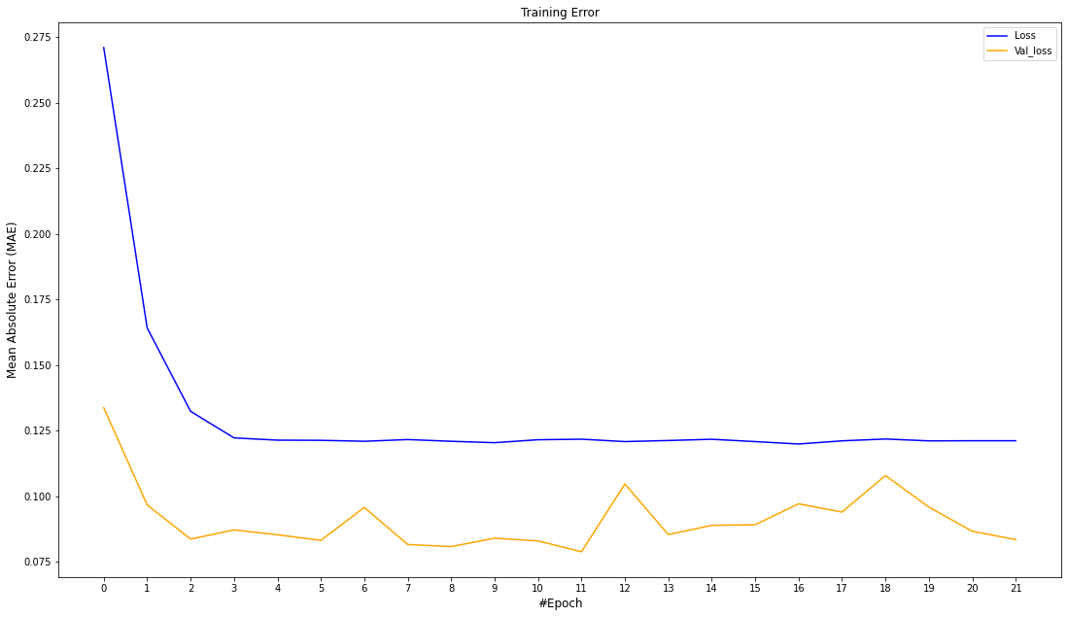
Regression with historical data and Social media feed - Results
Test set average MAE:
0.22

Slide 8
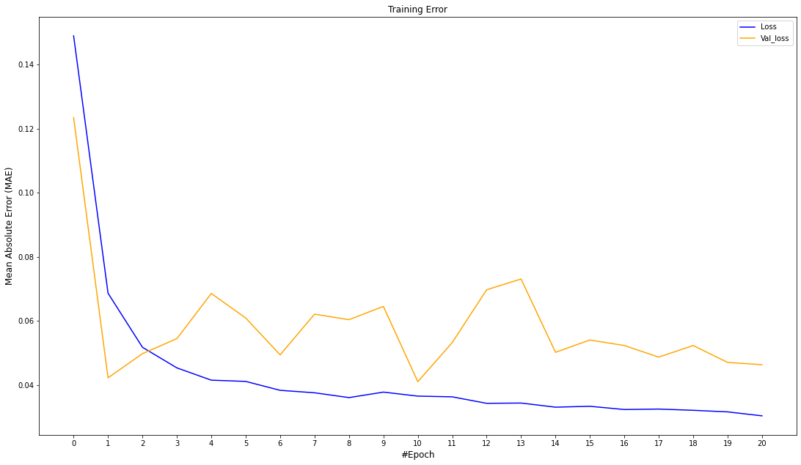
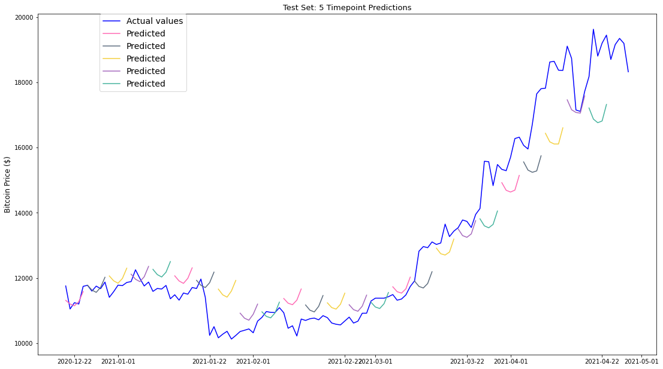
Regression with historical data and Social media feed - Results (MinMax normalization in whole dataset, social media included)
Test set average MAE:
0.90
Validation loss above training loss here!

Slide 9
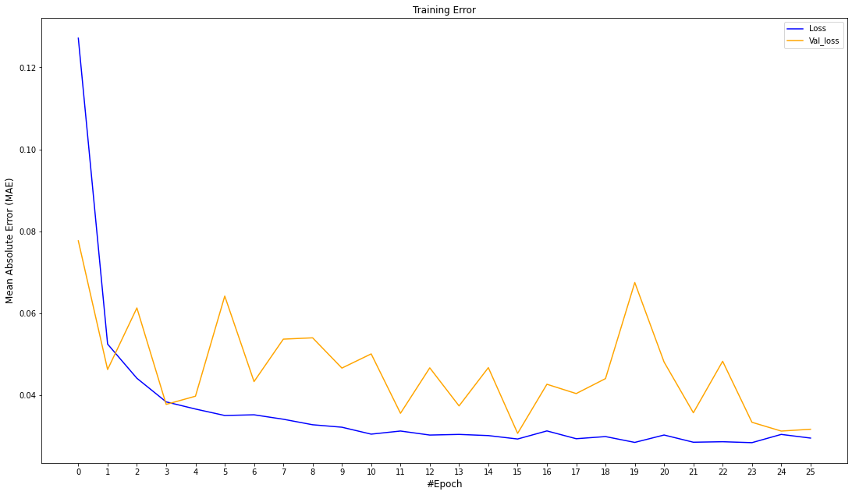
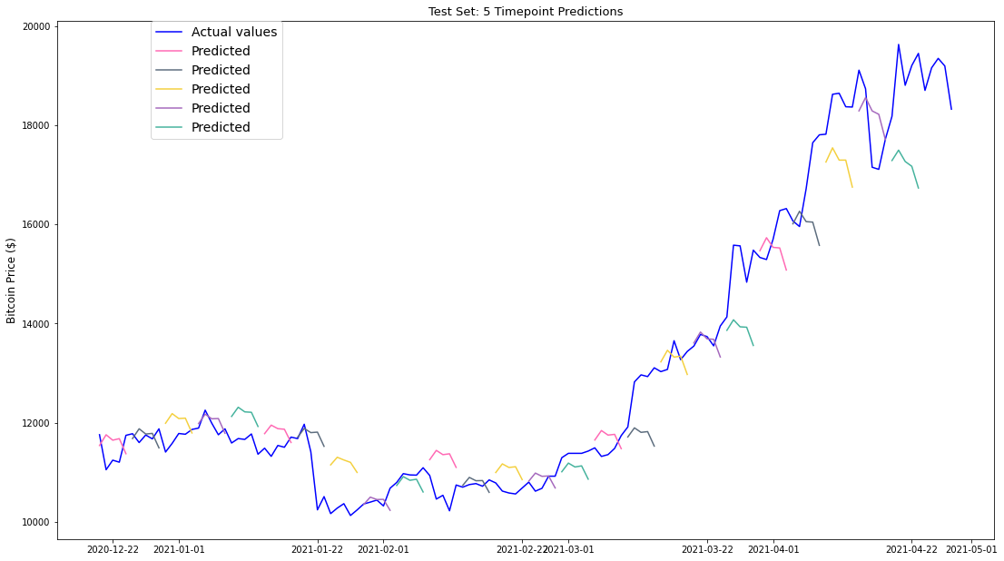
Regression with historical data and Social media feed - Results (MinMax normalization in whole dataset, social media not included)
Test set average MAE:
0.28
Seems social media actually decrease performance!

Slide 10

Classification with historical data
Even if we couldn’t achieve to predict the actual prices, the predictions follow the trend.
Instead of trying to predict the actual prices we will try to predict whether we will have a close price increase or decrease.
Pt: close value, μPt : Last 30 days average
Model architecture:
20 input GRU neurons
256 first dense neurons
40% percentage of first dropout
128 second dense neurons
25% percentage of second dropout
Loss function: Binary cross entropy
positive (1), else negative (0)

Slide 11
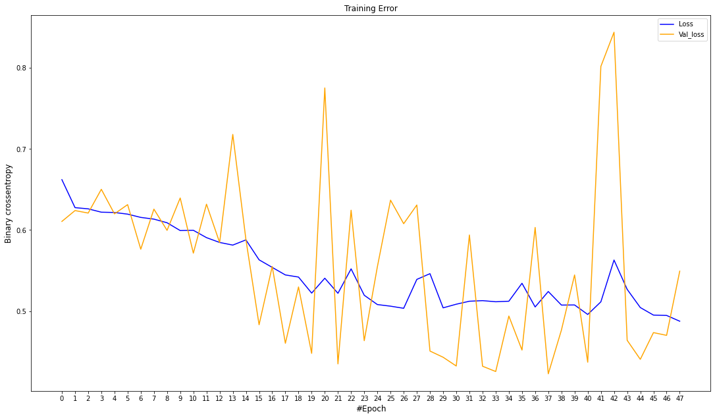
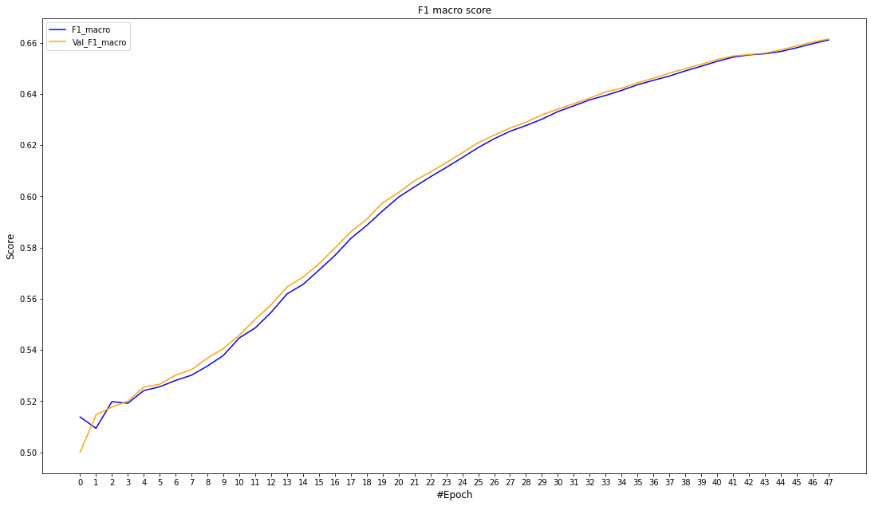
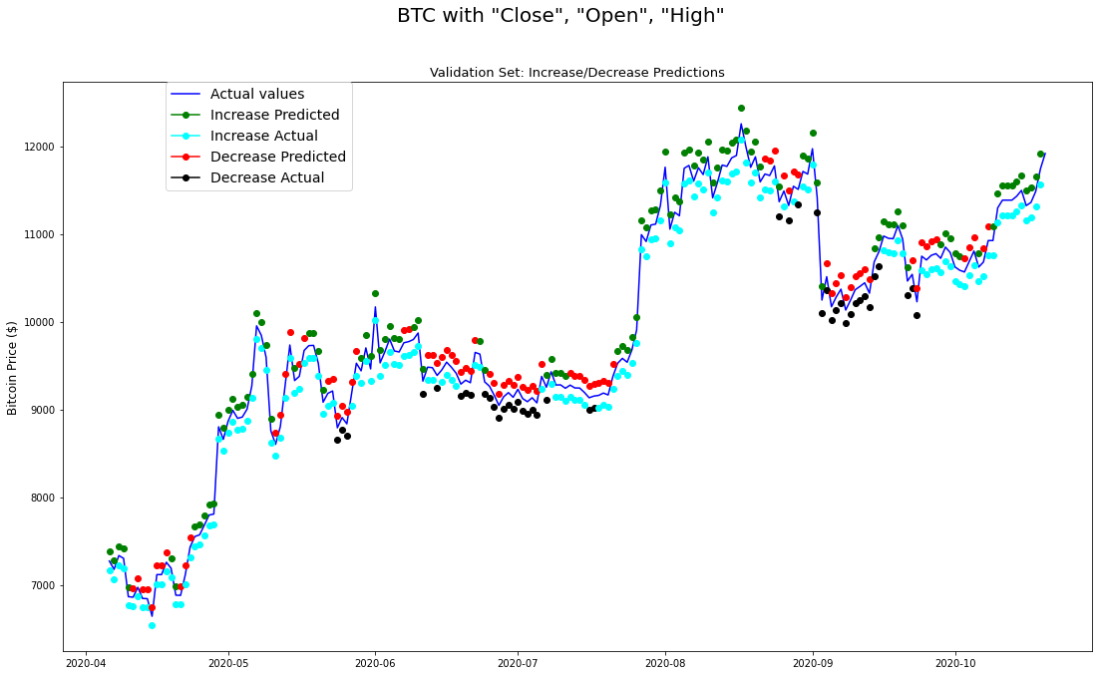
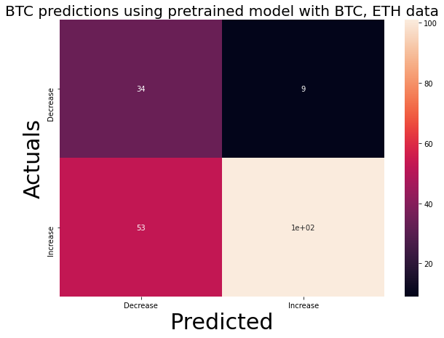
Classification with historical data - Results (1/2)
Validation loss decreases with strong oscillation!
Both train and validation F1 increases smoothly!
False more than half predicted as Decrease
Almost half of actual Increase misclassified
But, accuracy = 68%

Slide 12
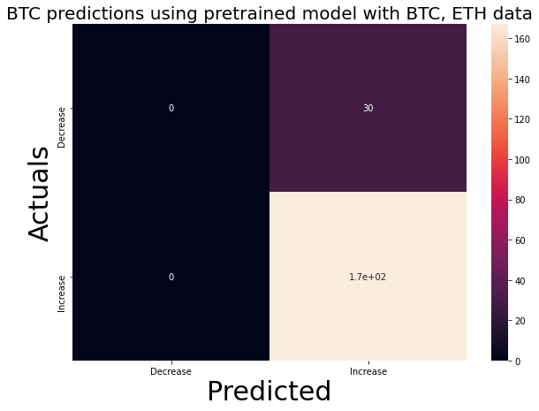
Classification with historical data - Results (2/2)
Even if the validation set’s results are somehow good, test set is biased to the increase class
test f1 score: 0.46 (<< validation set’s f1 score)

Slide 13
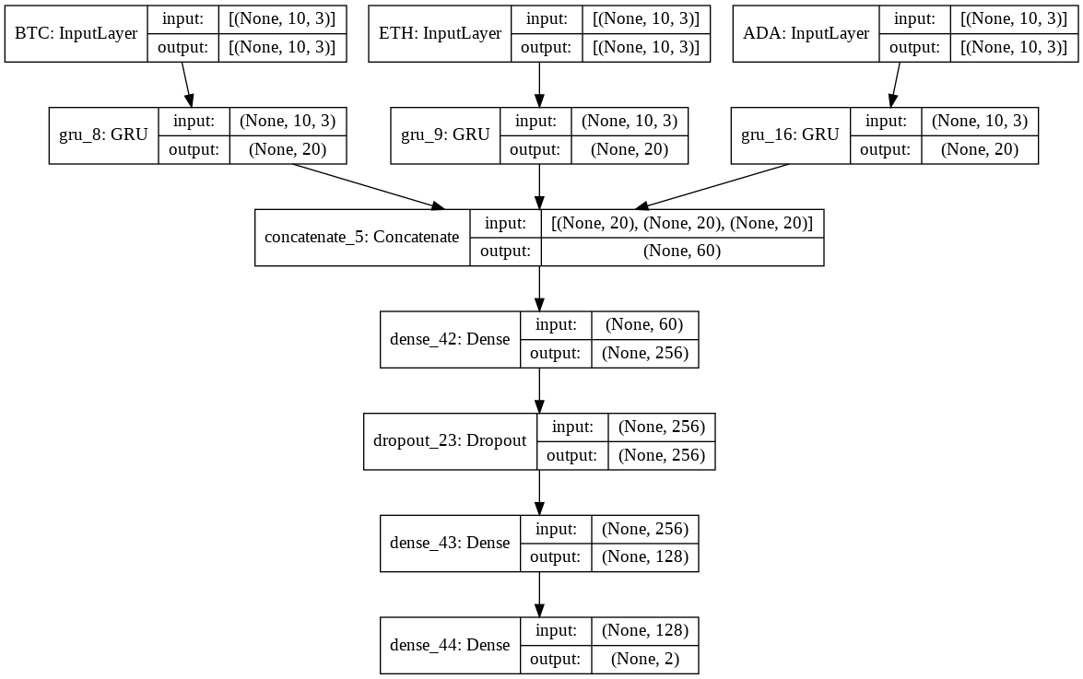
Concatenated models and transfer learning
Pretrained and frozen
Trainable
Train multiple sequential models with different coins
Combine them into one model using concatenated layer
Tried in regression problem but the results were not as good.
Passed trained weights in the concatenated model
Trained concatenated model by having pretrained ⅔ layers.
Target coin ADA.

Slide 14
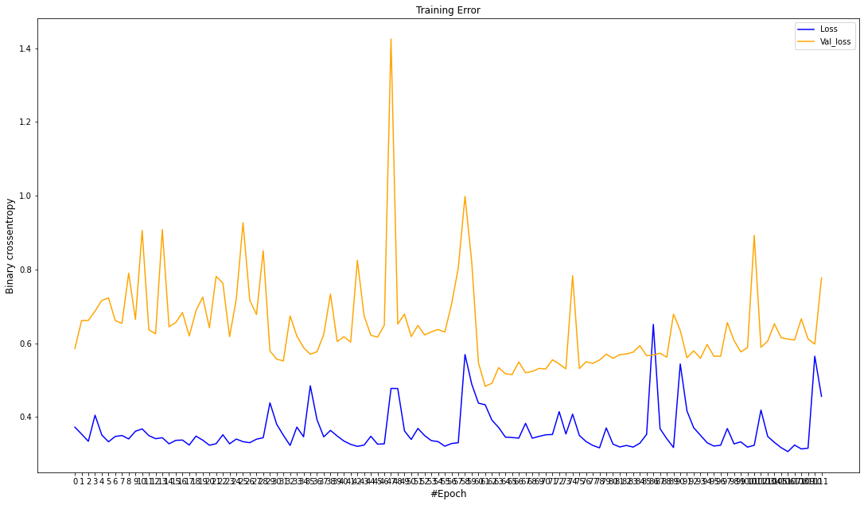
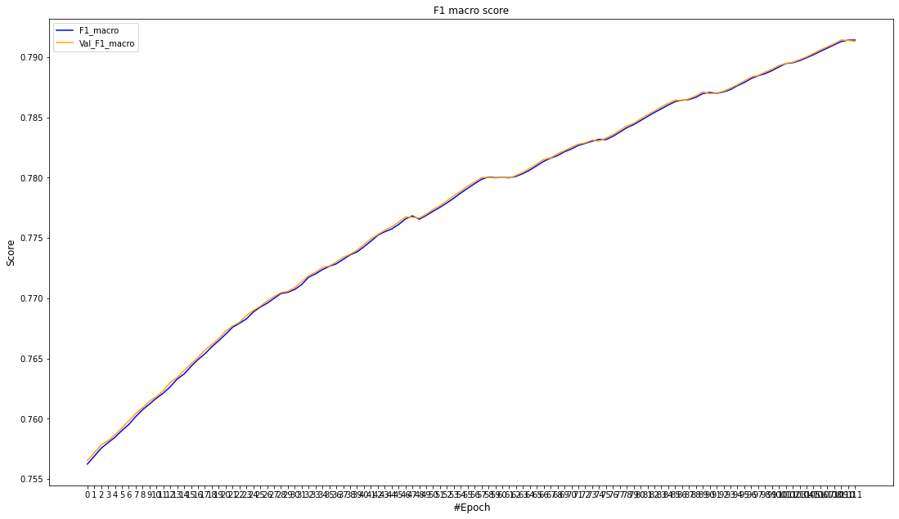
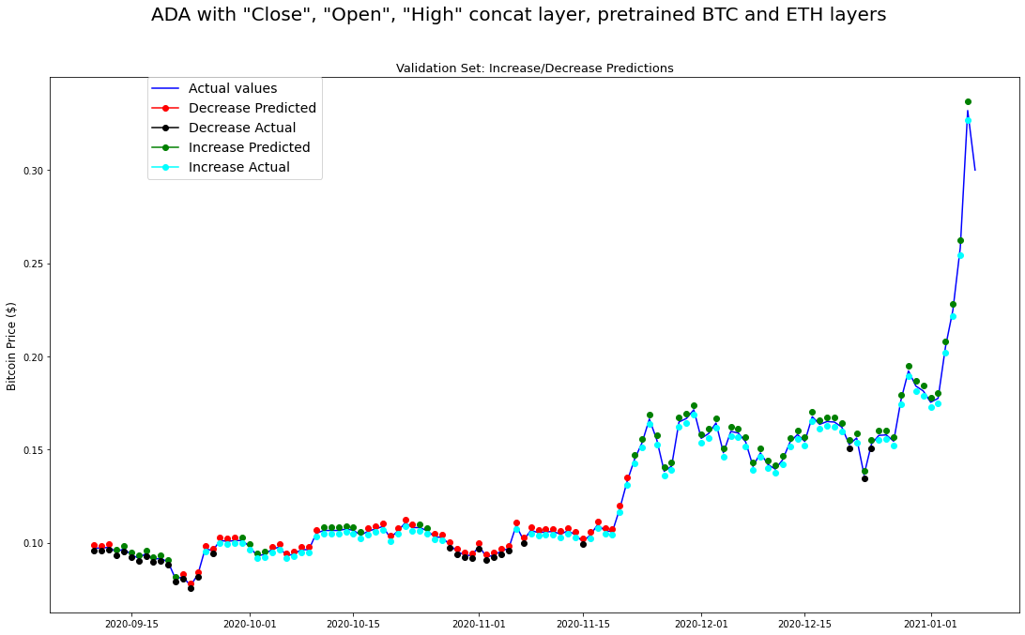
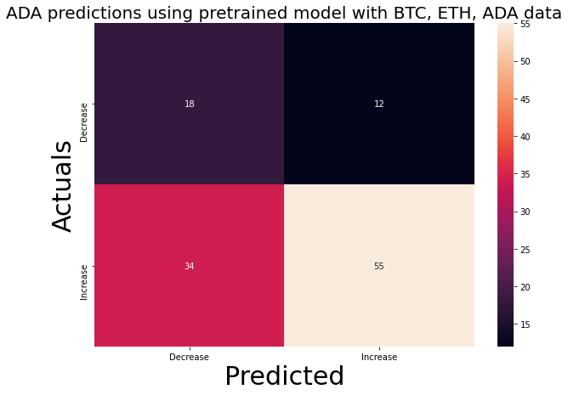
Concatenated models and transfer learning - Results
Losses do not decrease
But F1’s still increase and reach higher than before!
Similar results as without transfer learning both for validation and test

Slide 15
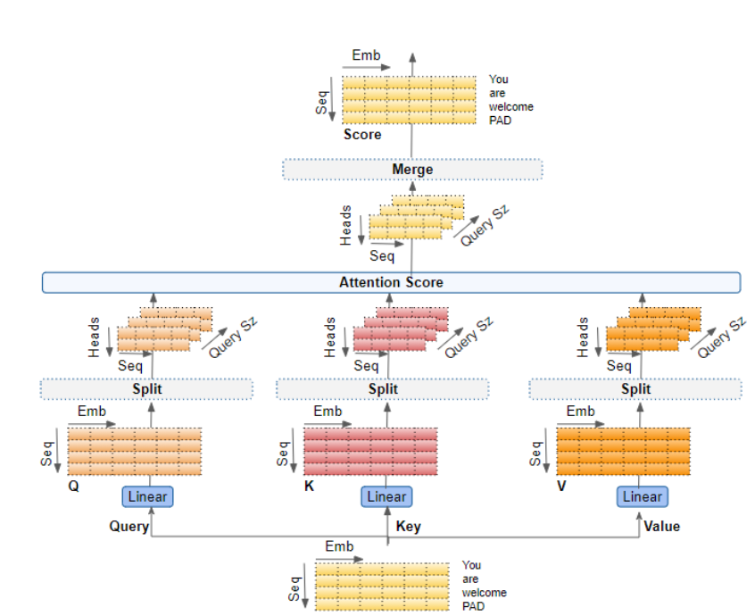
Conclusion
Future work
Unfortunately, the results are not as good. But, maybe there is an explanation!
Test stationarity with Augmented Decay Fuller statistical test:
ADF for original BTC Time Series:
ADF Statistic: 0.923242
p-value: 0.993386
Perform experiments using Transformers architecture.
Multi-head attention concept is indicated for such complex sequences.
Image taken from [4]

Slide 16
References
I. E. Livieris, N. Kiriakidou, S. Stovroyiannisn and P. Pintelas, "An Advanced CNN-LSTM Model for Cryptocurrency Forecasting," Electronics, vol. 10, no. 3, pp. 287, Jan. 2021, doi: 10.3390/electronics10030287.
E. Christoforou, Z. I. Emiris and A. Florakis, "Neural Networks for Cryptocurrency Evaluation and Price Fluctuation Forecasting," in Mathematical Research for Blockchain Economy, P. Pardalos, I. Kotsireas, Y. Guo, W. Knottenbelt, Eds. Springer, Cham, 2020, pp. 133-149, doi: 10.1007/978-3-030-37110-4_10.
I. E. Livieris, S. Stavroyiannis, E. Pintelas and P. Pintelas, "A novel validation framework to enhance deep learning models in time-series forecasting," Neural Computing and Applications, vol. 32, pp. 17149–17167, 08 Jul. 2020, doi: 10.1007/s00521-020-05169-y.
K. Doshi, “Transformers Explained Visually (Part 3): Multi-head Attention, deep dive,” Towards data science [Online]. Available: https://towardsdatascience.com/transformers-explained-visually-part-3-multi-head-attention-deep-dive-1c1ff1024853 [Accessed Jul. 4, 2021].

